Slide 1
Mock Lecture Assumptions
Previous lecture introducing Data Science Lifecycle
Previous lecture/lab on AI Context/Prompt Engineering
Introductory Python Experience (Prior Python Class)
Previous lecture on Jupyter Notebooks
Optional: Basic understanding of linear algebra and basic statistics
Full attribution (credit) has not been completed for slides
Approach
Focus on application in data science

Slide 2

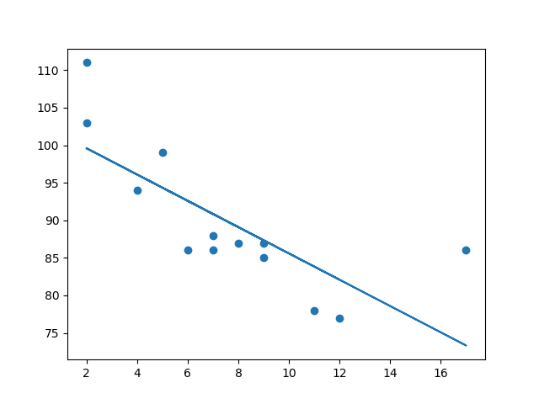
Introduction to Linear Regression
Gregory L. Gunther
Data Science 101
For Data Scientists

Slide 3

I’m Greg!
Today’s Learning Outcomes
-Learn where regression models “live” in the Data Science Lifecycle and explore real world implications of using linear regression.
-Gain practical experience engaging in business use cases and common data considerations related to Linear Regression in analysis.
-Explore introductory knowledge of Simple Linear Regression under the hood.
-Practice developing a Simple Linear Regression model using Python and AI (CLAUDE).
N E X T

Slide 4

Linear Regresssion
& The Data
Science Life
Cycle
Business Understanding
Data Collection
Data Preparation
Exploratory Data Analysis (EDA)
Modeling the Data
Model Evaluation
Model Deployment
N E X T
(modified IBM Data
Science Lifecycle)
Notes:
Before we begin, lets review the Data Science Life Cycle and where regression fits in
At first glance, linear regression is a modeling technique

Slide 5
Linear Regression is technique used in data science to analyze and model the relationship between a dependent variable (target) and one or more independent variables (predictors).
Linear Regression In Data Science
GOAL = Prediction
N E X T
Predictor
Independent Variable
‘highway_mpg’
“65 MPG”
Target
Dependent Variable
‘predicted_price’
“$35,000”
Model

Slide 6
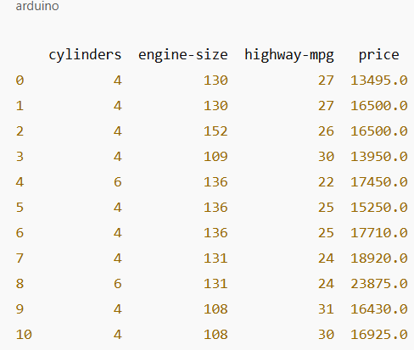
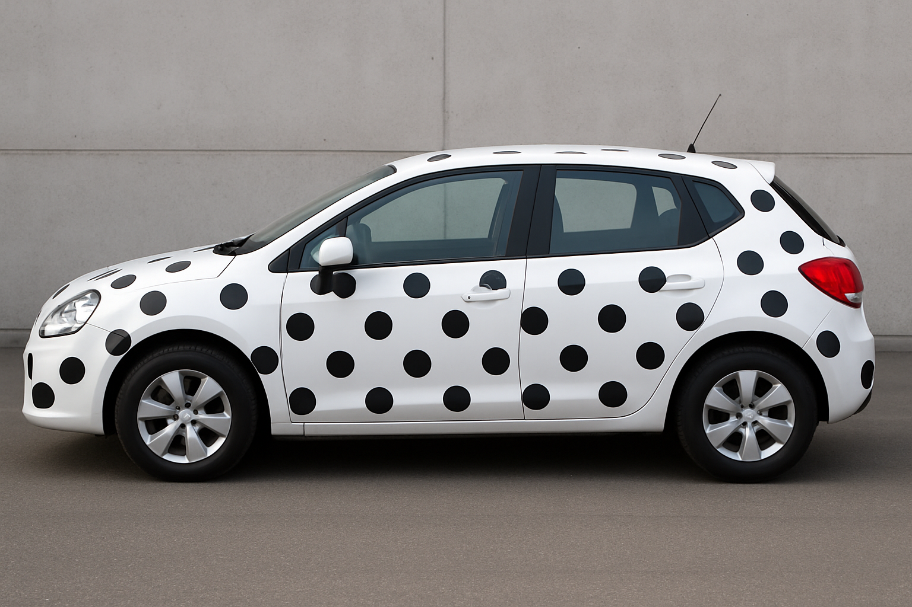

Use Case and Data Considerations
Questions To Consider!
Are there multiple variables that could improve your model?
Are there anomalies (really high or really low values)
Do you have the data and can you get it.
Dependent Variable
Independent Variables
Regression Model
N E X T
‘highway_mpg’
‘engine_size’
‘cylinders’
Y = $20,000
Regression Model
Y = $20,000
‘highway_mpg’
‘engine_size’
‘cylinders’
(dataset generated using GhatGPT OMNI on 05/2025, original data source https://cf-courses-data.s3.us.cloud-object-storage.appdomain.cloud/IBMDeveloperSkillsNetwork-DA0101EN-SkillsNetwork/labs/Data%20files/automobileEDA.csv)
Notes:
The relevance, quality and number of input variables impacts the quality of your regression model!

Slide 7
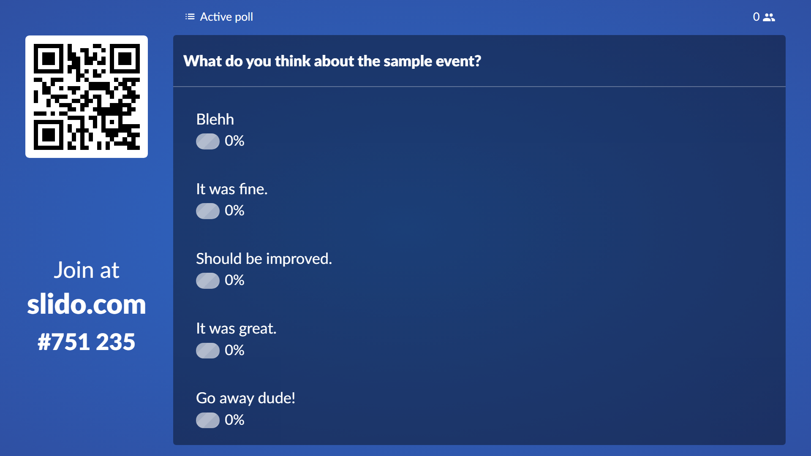
Use Case: Estimate the sale price of a house based on its characteristics
Use Case: Determine a car’s fuel efficiency based on its specifications.
.
.
Independent
(Predictors)
Dependent
(Target)
Independent
(Predictors)
Variables
Dependent
(Target)
Variables
Square Footage
Number of Bedrooms
Number of Bathrooms
Age of the House
Sale Price
Distance to City Center
Engine Size (liters)
Vehicle Weight
Horsepower
Number of Cylinders
Miles Per Gallon (MPG)

Slide 8

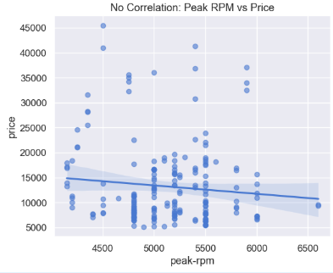
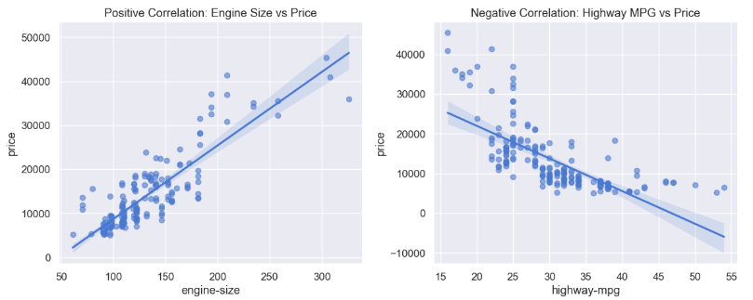
Is There a Relationship? Correlation (Pearson) Statistics
Measures to what extent variables are interdependent
Examples -Physical Fitness - Resting Heart Rate -Alcohol Consumption - Liver Disease
Correlation does not mean Causation! -Rain – Umbrella: Correlated but one doesn’t CAUSE the other
N E X T

Slide 9


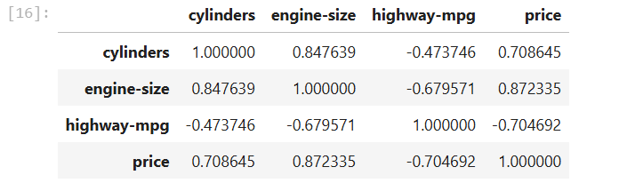


Correlation (Pearson)
Statistics
The Scale
r = +1: Perfect positive correlation
r = 0: No linear relationship
r = -1: Perfect negative correlation
My Skills
High correlation (r ≈ 0.9): Height and weight
Marginal correlation (r ≈ 0.3): Exercise and mood
No correlation (r ≈ 0): Hair color and intelligence
N E X T
Notes:
Before we begin, lets review the Data Science Life Cycle and where regression fits in
At first glance, linear regression is a modeling technique

Slide 10
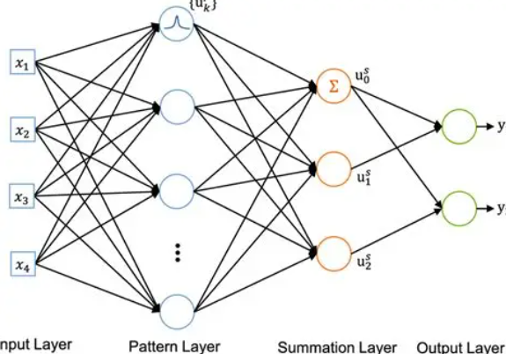
Regression
in Data
Science
LINEAR REGRESSION MODELS
Simple Linear Regression
Multiple Linear
Polynomial
Ridge
Lasso
Elastic
Ordinal
Logistical
NON LINEAR REGRESSION MODELS
N E X T
Decision Tree
Gradient Boosting
Random Forrest
Support Vector
Neural Network
K-Nearest Neighbor
Gaussian Process
Kernel Ridge
(Classification and graphics generated using GhatGPT OMNI on 05/2025)
Notes:
Regression is the cornerstone of predictive analytics in data science, enabling us to quantify relationships between variables and make data-driven predictions, with dozens of specialized models ranging from simple linear regression to complex neural networks, each designed to capture different types of patterns in data and solve diverse business problems across industries.

Slide 11
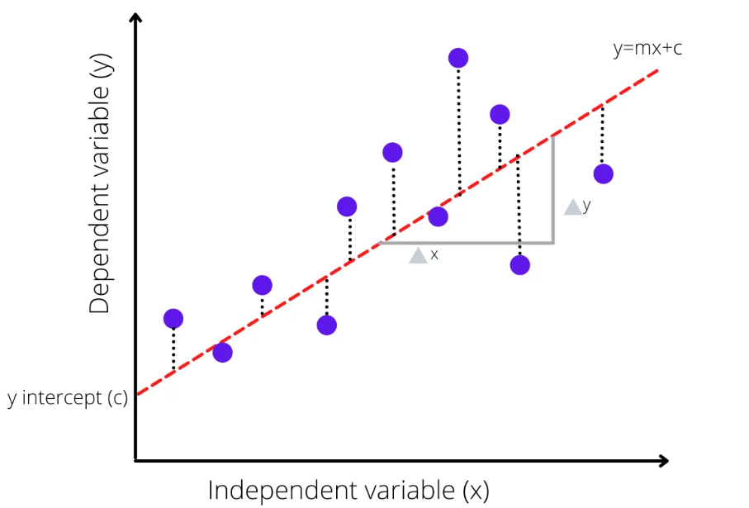


Simple Linear Regression
My Skills
“Reliant on 1 independent variable (predictor) to make a prediction”
The predictor (independent) variable = X
The target (dependent) variable = Y
y = b₀ + b₁x
N E X T
Model Parameters
(Generated during model fit or training process based on training dataset)
b₁
b_{o} = intercept
b₀
(graphic used with permission from Medium blog Simple Linear Regression Using Example. | by SACHIN H S | Medium)
b₁ = slope

Slide 12
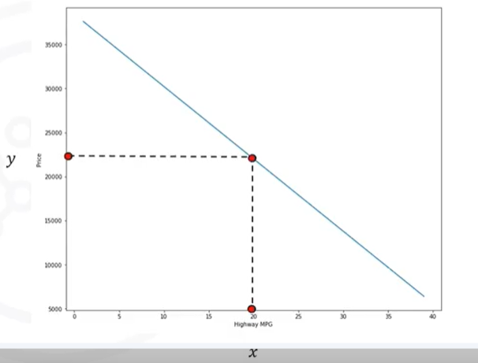
Simple Linear Regression Prediction
My Skills
Now you have a Model!
Model Fit or Training Process
ŷ = 38423 – 821x
Example: Predict Car Price Based on MPG
Given: ŷ = 38423 – 821x
= 38423 – 821(20)
= $22,003
N E X T
ŷ = Prediction
x = 20 MPG
y is now ŷ

Slide 13
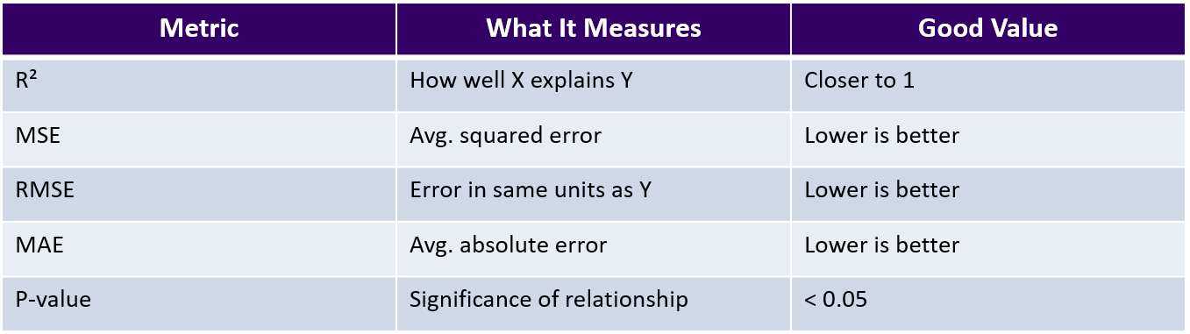
Model Evaluation (Simplified)
My Skills
N E X T

Slide 14
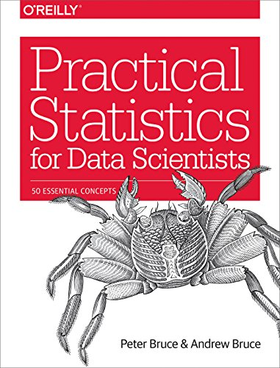
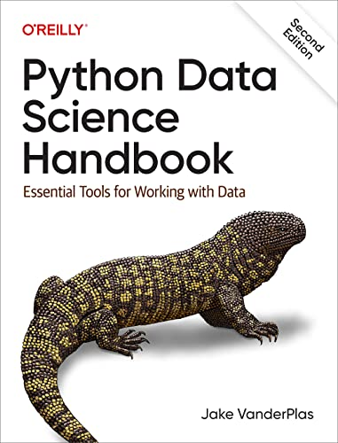
References
My Skills
Bruce, Peter, and Andrew Bruce. Practical Statistics for Data Scientists: 50 Essential Concepts. O'Reilly Media, 2017.
VanderPlas, Jake. Python Data Science Handbook: Essential Tools for Working with Data. O'Reilly Media, 2016.
No correlation (r ≈ 0): Hair color and intelligence
N E X T

Slide 15
Let’s Practices Using Python and Claude
Requirements
Dataset
Jupyter Lab
Python Packages
pandas
seaborn
Sklearn
N E X T

